Slide 1
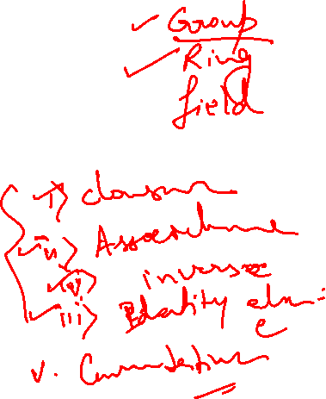
School of Computing Science and Engineering
Course Code: BCSE2350 Course Name: Cryptographic Fundamental
Mathematics of Cryptography

Slide 2
INTEGER ARITHMETIC
In integer arithmetic, we use a set and a few operations. You are familiar with this set and the corresponding operations, but they are reviewed here to create a background for modular arithmetic.
Topics discussed in this section:
Set of Integers
Binary Operations
Integer Division
Divisibility

Slide 3


Set of Integers
The set of integers, denoted by Z, contains all integral numbers (with no fraction) from negative infinity to positive infinity

Slide 4
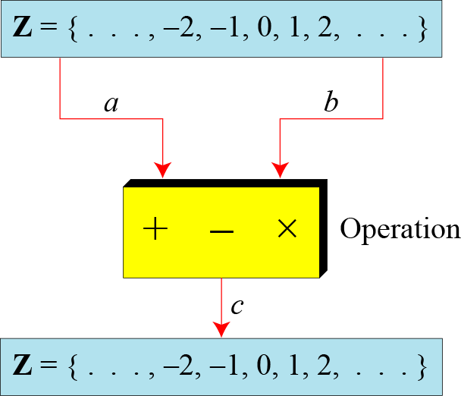
Binary Operations
In cryptography, we are interested in three binary operations applied to the set of integers. A binary operation takes two inputs and creates one output.

Slide 5
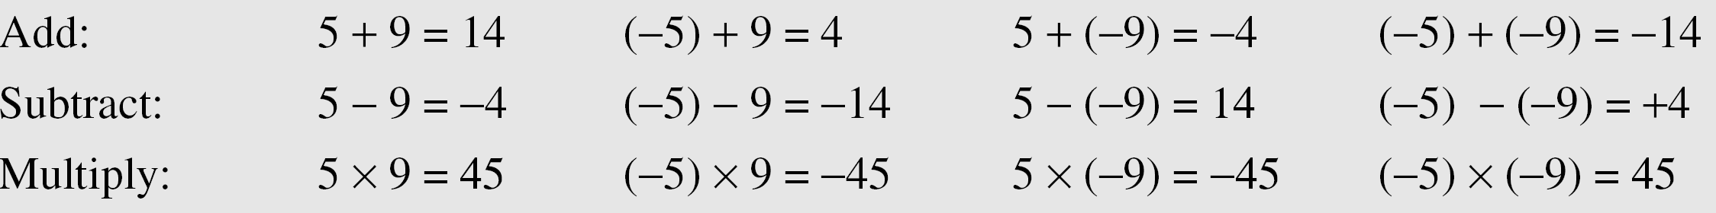
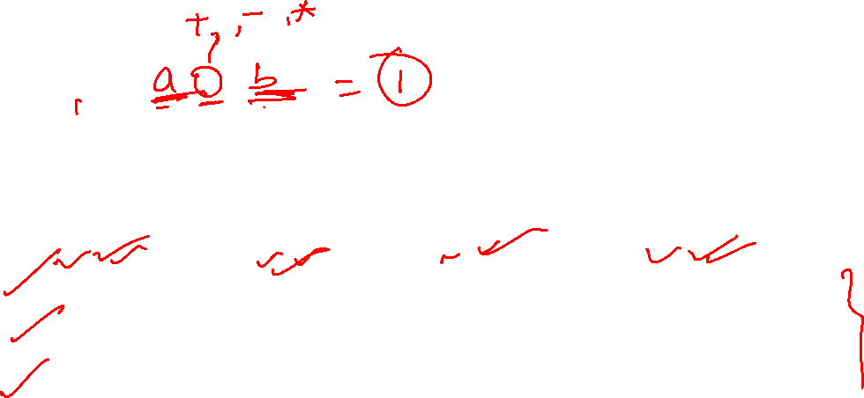
The following shows the results of the three binary operations on two integers. Because each input can be either positive or negative, we can have four cases for each operation.

Slide 6
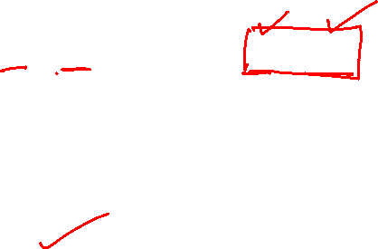
Integer Division
In integer arithmetic, if we divide a by n, we can get q And r . The relationship between these four integers can be shown as
a = q × n + r

Slide 7
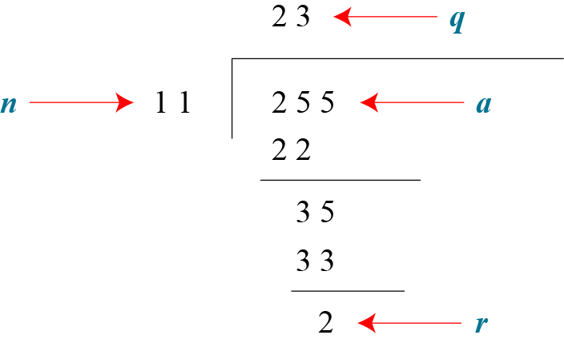
Assume that a = 255 and n = 11. We can find q = 23 and R = 2 using the division algorithm.

Slide 8
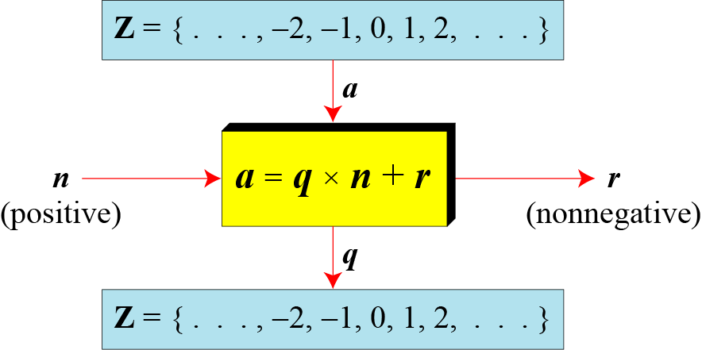
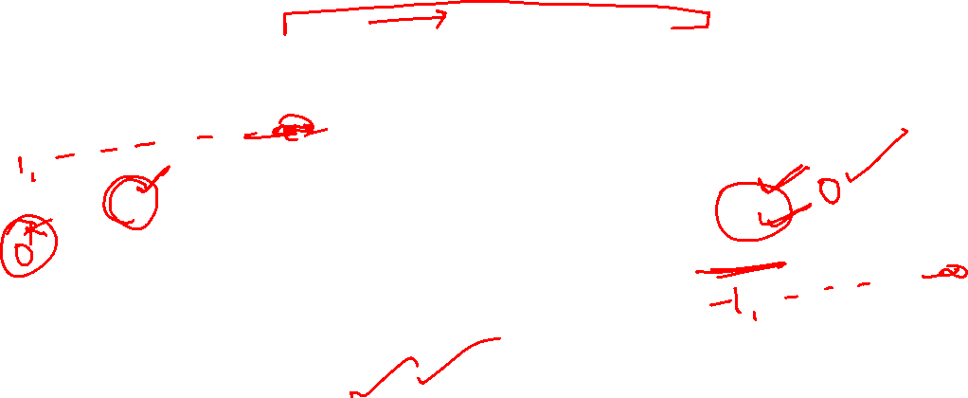

Slide 9
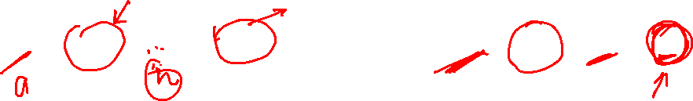
When we use a computer or a calculator, r and q are negative when a is negative. How can we apply the restriction that r needs to be positive? The solution is simple, we decrement the value of q by 1 and we add the value of n to r to make it positive.

Slide 10
Divisbility
If a is not zero and we let r = 0 in the division relation, we get
a = q × n
If the remainder is zero,
If the remainder is not zero,

Slide 11
The integer 4 divides the integer 32 because 32 = 8 × 4. We show this as
The number 8 does not divide the number 42 because
42 = 5 × 8 + 2. There is a remainder, the number 2, in the equation. We show this as

Slide 12
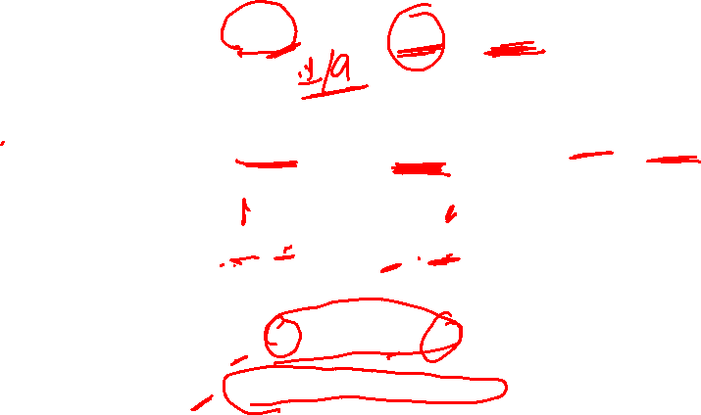
Property 1: if a|1, then a = ±1.
Property 2: if a|b and b|a, then a = ±b.
Property 3: if a|b and b|c, then a|c.
Property 4: if a|b and a|c, then a|(m × b + n × c), where m and n are arbitrary integers

Slide 15
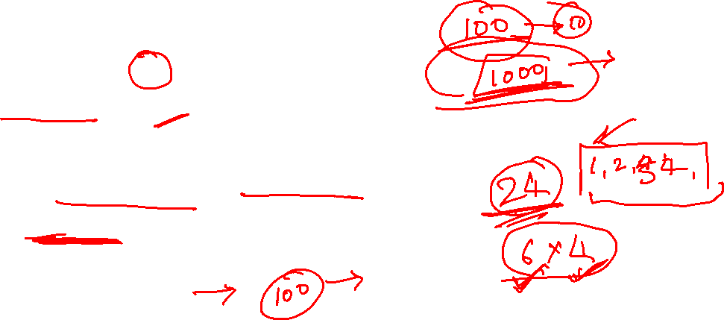
Fact 1: The integer 1 has only one divisor, itself.
Fact 2: Any positive integer has at least
two divisors, 1 and itself (but it can have more).

Slide 16
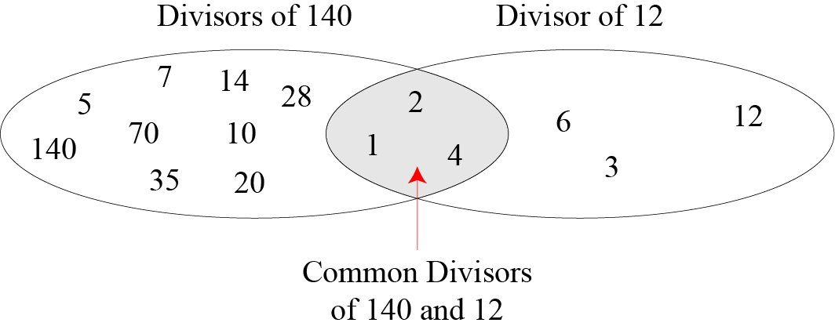
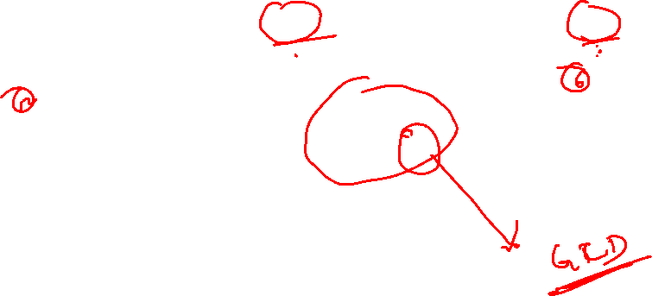

Slide 17
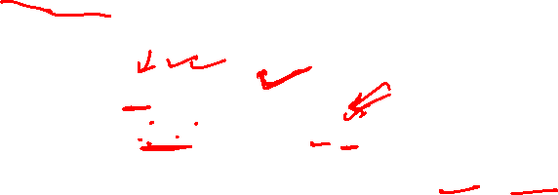
Greatest Common Divisor
The greatest common divisor of two positive integers is the largest integer that can divide both integers.
Euclidean Algorithm
Fact 1: gcd (a, 0) = a Fact 2: gcd (a, b) = gcd (b, r), where r is the remainder of dividing a by b

Slide 18
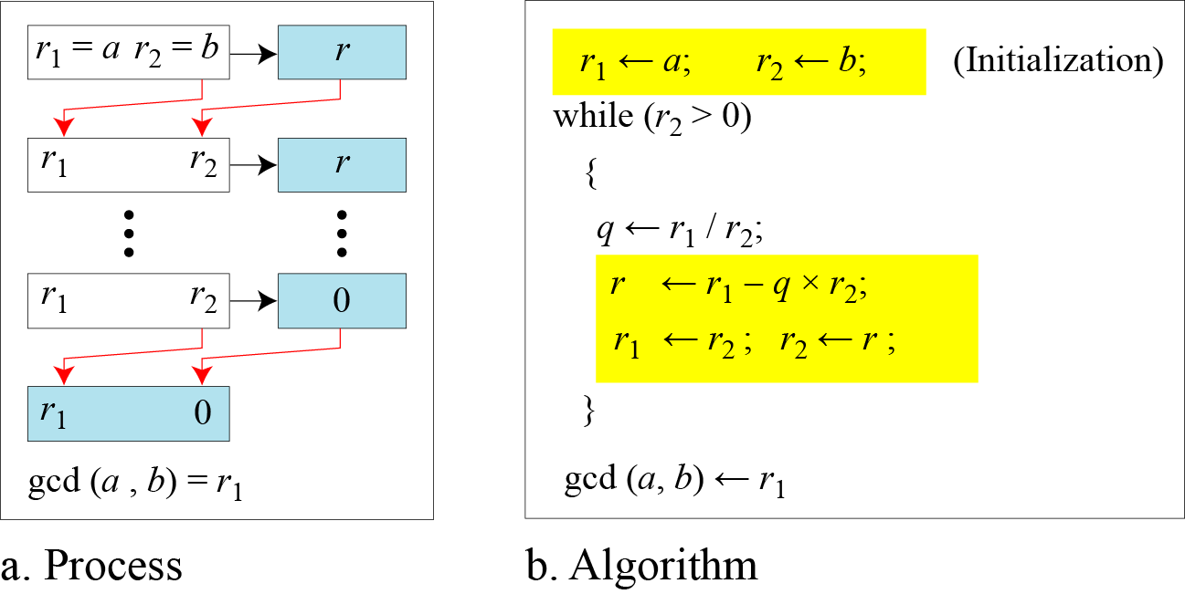
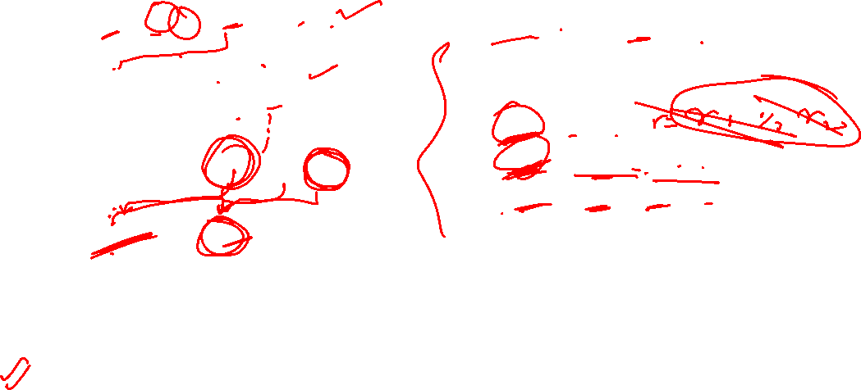
When gcd (a, b) = 1, we say that a and b are relatively prime.

Slide 19
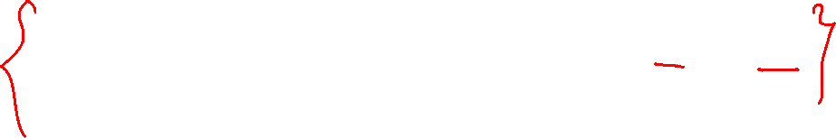
When gcd (a, b) = 1, we say that a and b are relatively prime.

Slide 20
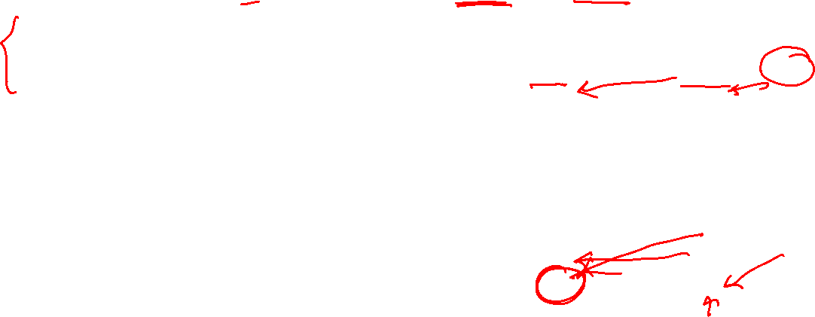
Find the greatest common divisor of 2740 and 1760.
Solution
We have gcd (2740, 1760) = 20.

Slide 21


Extended Euclidean Algorithm
Given two integers a and b, we often need to find other two integers, s and t, such that
The extended Euclidean algorithm can calculate the gcd (a, b) and at the same time calculate the value of s and t.

Slide 22
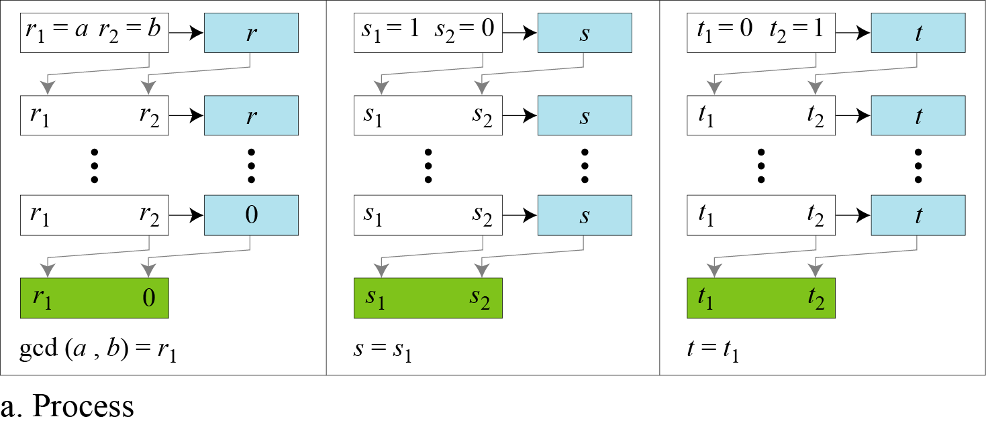
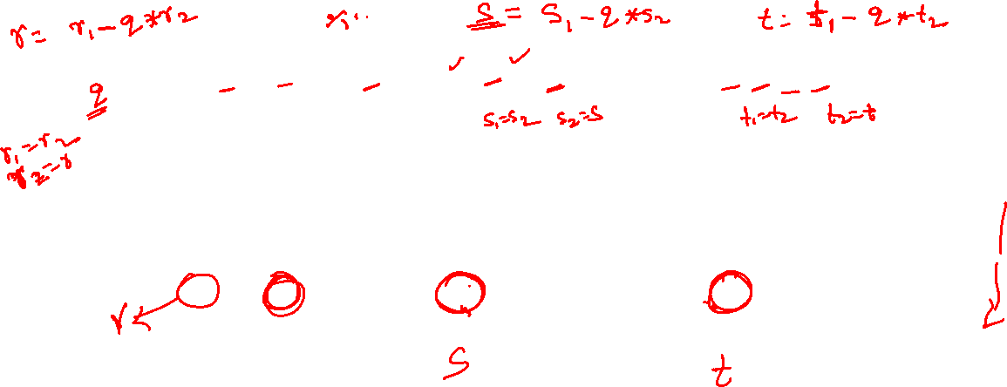

Slide 23
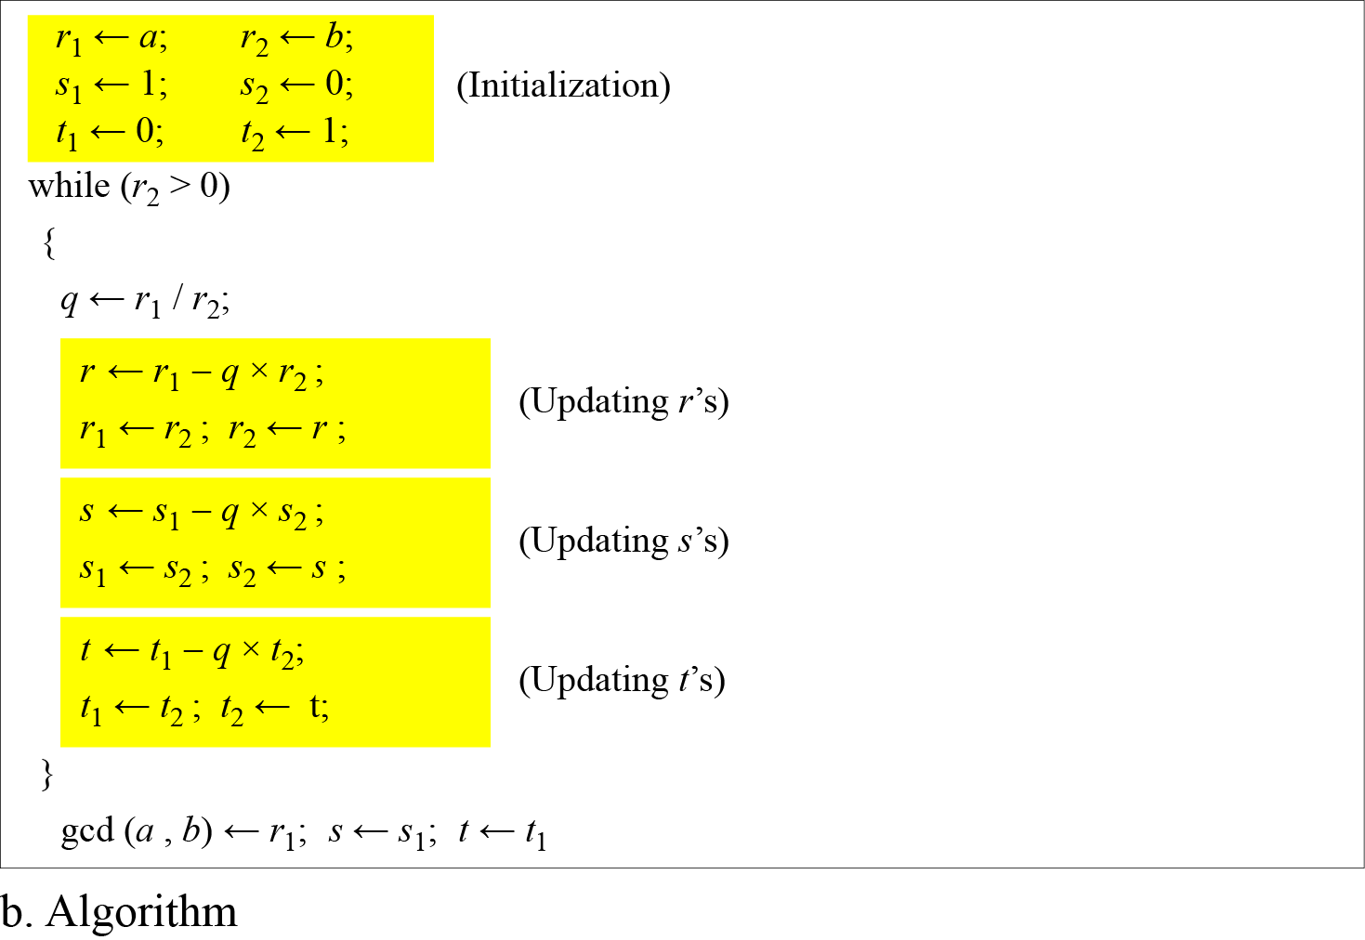

Slide 24
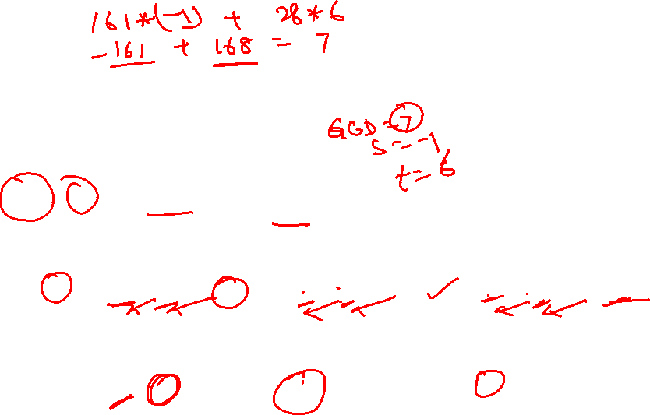
Given a = 161 and b = 28, find gcd (a, b) and the values of s and t.
Solution
We get gcd (161, 28) = 7, s = −1 and t = 6.

Slide 25
MODULAR ARITHMETIC
The division relationship (a = q × n + r) discussed in the previous section has two inputs (a and n) and two outputs (q and r). In modular arithmetic, we are interested in only one of the outputs, the remainder r.

Slide 26
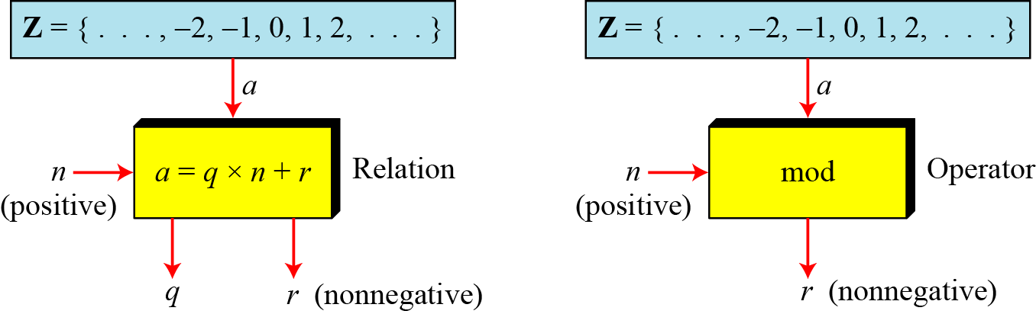
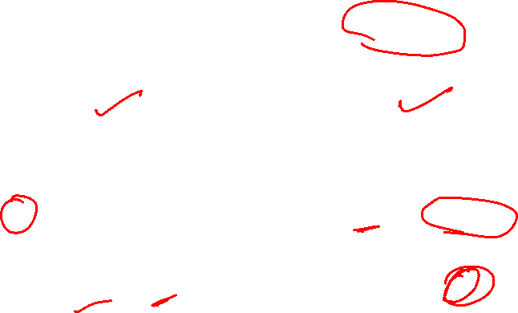
Modulo Operator
The modulo operator is shown as mod. The second input (n) is called the modulus. The output r is called the residue.

Slide 27
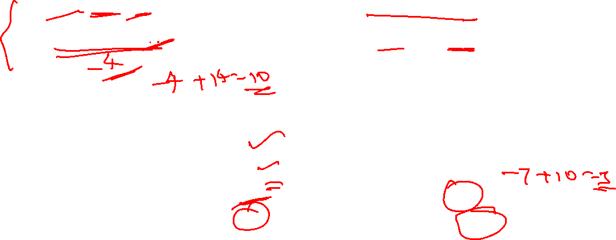
Find the result of the following operations:
a. 27 mod 5 b. 36 mod 12
c. −18 mod 14 d. −7 mod 10
Solution
Dividing 27 by 5 results in r = 2
Dividing 36 by 12 results in r = 0.
c. Dividing −18 by 14 results in r = −4. After adding the modulus r = 10
d. Dividing −7 by 10 results in r = −7. After adding the modulus to −7, r = 3.

Slide 28
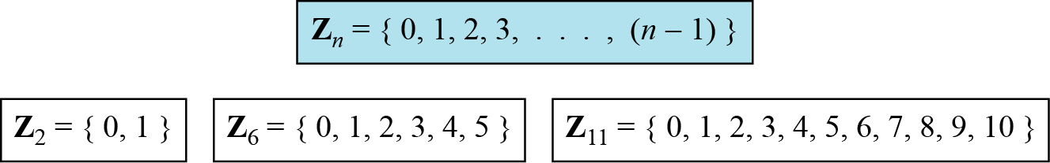
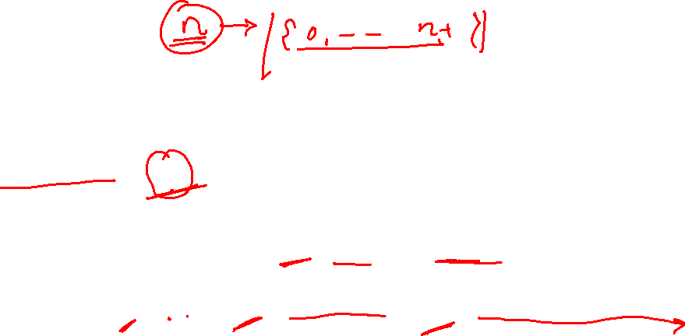
Set of Residues
The result of the modulo operation with modulus n is always an integer between 0 and n-1. The modulo operation creates a set, which in modular arithmetic is referred to as the set of least residues modulo n, or Z_{n}.

Slide 29
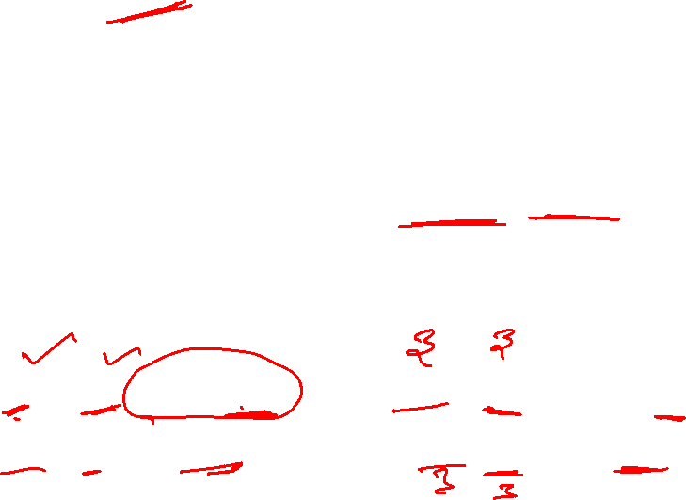
Congruence
In cryptography, we often use the concept of congruence instead of equality. To show that two integers are congruent, we use the congruence operator ( ≡ ). We add the phrase (mod n) to the right side of the congruence to define the value of modulus that makes the relationship valid. For example, we write:

Slide 30
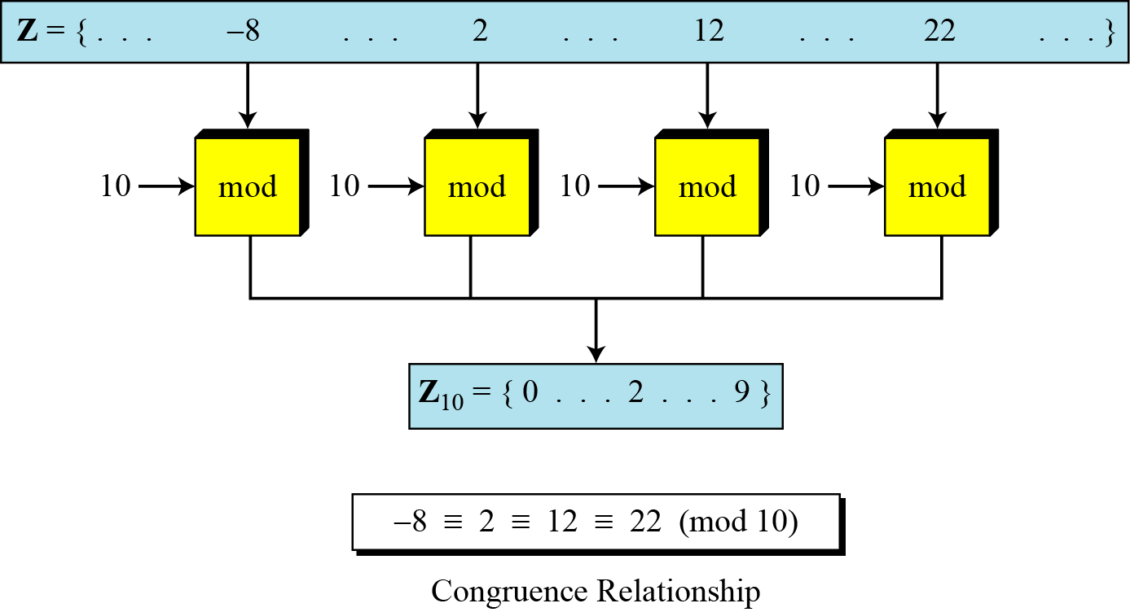
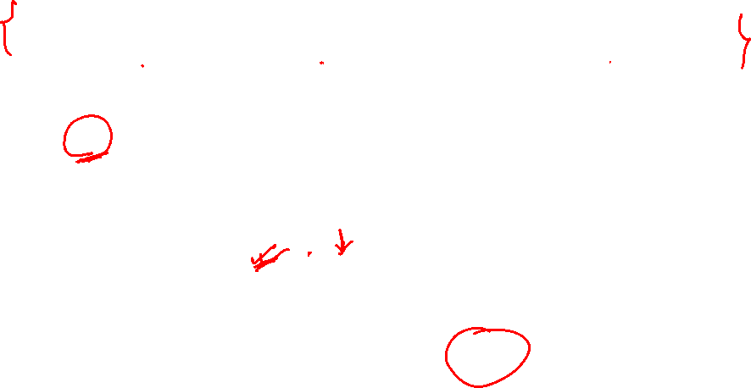

Slide 31
We use modular arithmetic in our daily life; for example, we use a clock to measure time. Our clock system uses modulo 12 arithmetic. However, instead of a 0 we use the number 12.

Slide 32
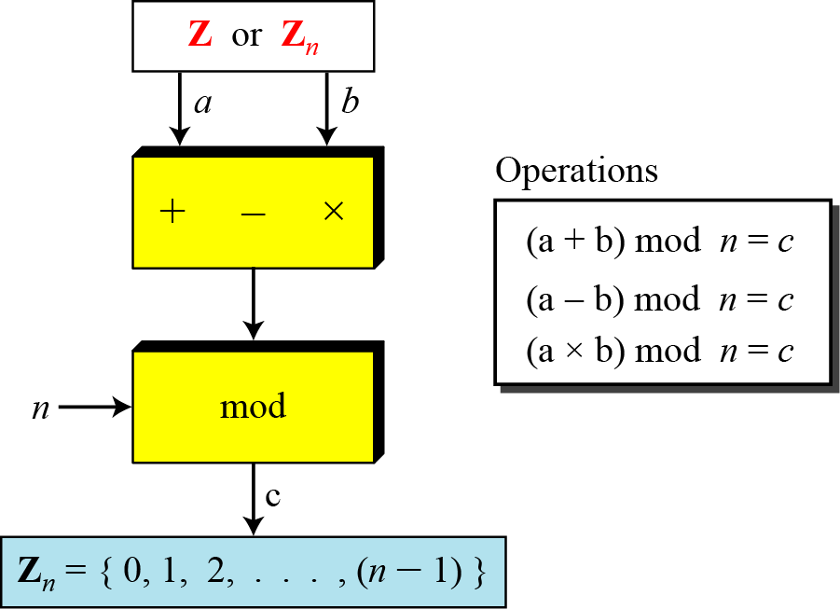
Operation in Z_{n}
The three binary operations that we discussed for the set Z can also be defined for the set Zn. The result may need to be mapped to Zn using the mod operator.

Slide 33
Perform the following operations (the inputs come from Zn):
a. Add 7 to 14 in Z15.
b. Subtract 11 from 7 in Z13.
c. Multiply 11 by 7 in Z20.
Solution

Slide 34
Properties

Slide 35
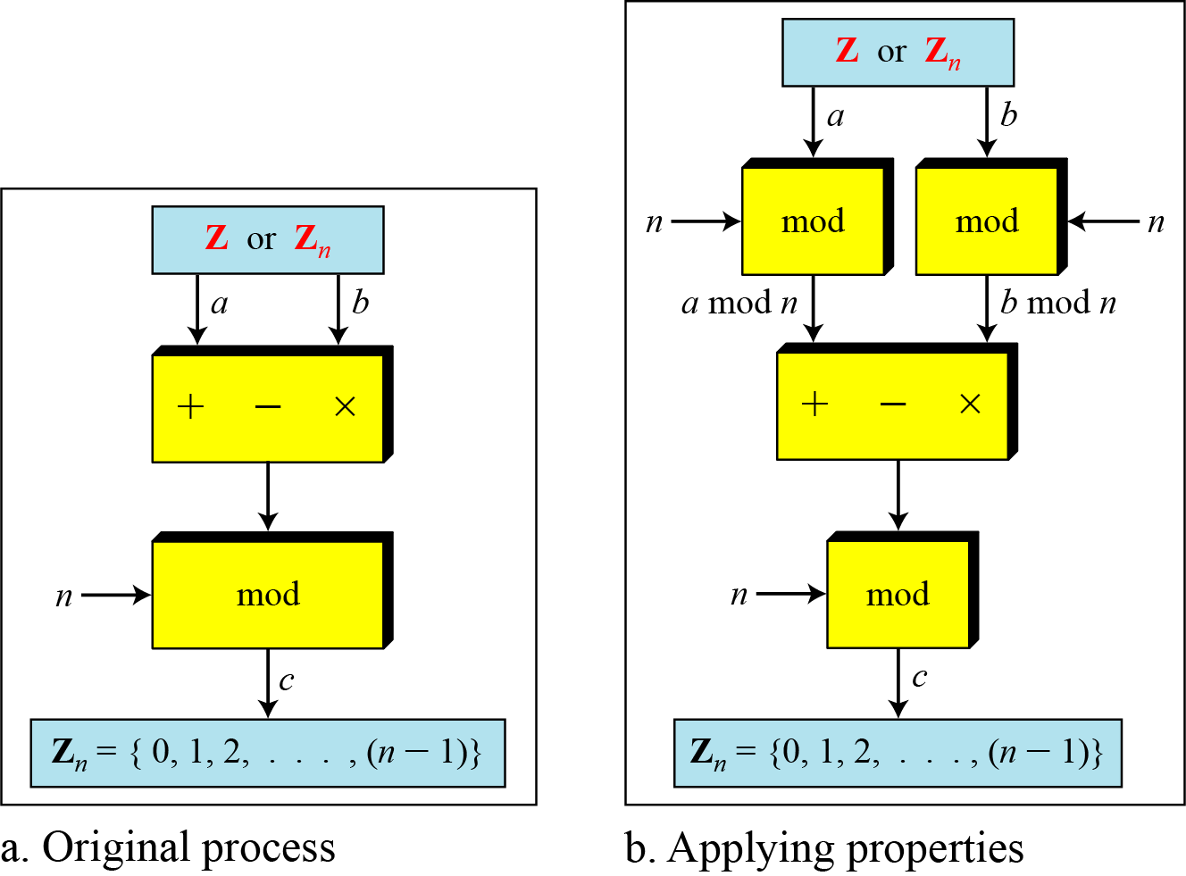

Slide 36
The following shows the application of the above properties:
1. (1,723,345 + 2,124,945) mod 11 = (8 + 9) mod 11 = 6
2. (1,723,345 − 2,124,945) mod 16 = (8 − 9) mod 11 = 10
3. (1,723,345 × 2,124,945) mod 16 = (8 × 9) mod 11 = 6

Slide 37
In arithmetic, we often need to find the remainder of powers of 10 when divided by an integer.

Slide 38
We have been told in arithmetic that the remainder of an integer divided by 3 is the same as the remainder of the sum of its decimal digits. We write an integer as the sum of its digits multiplied by the powers of 10.

Slide 39
Inverses
When we are working in modular arithmetic, we often need to find the inverse of a number relative to an operation. We are normally looking for an additive inverse (relative to an addition operation) or a multiplicative inverse (relative to a multiplication operation).

Slide 40

Additive Inverse
In Z_{n}, two numbers a and b are additive inverses of each other if
In modular arithmetic, each integer has an additive inverse. The sum of an integer and its additive inverse is congruent to 0 modulo n.

Slide 41
Find all additive inverse pairs in Z10.
Solution
The six pairs of additive inverses are (0, 0), (1, 9), (2, 8), (3, 7), (4, 6), and (5, 5).

Slide 42

Multiplicative Inverse
In Zn, two numbers a and b are the multiplicative inverse of each other if
In modular arithmetic, an integer may or may not have a multiplicative inverse.
When it does, the product of the integer and its multiplicative inverse is congruent to 1 modulo n.

Slide 43
Find the multiplicative inverse of 8 in Z₁₀.
Solution
There is no multiplicative inverse because gcd (10, 8) = 2 ≠ 1. In other words, we cannot find any number between 0 and 9 such that when multiplied by 8, the result is congruent to 1.
Find all multiplicative inverses in Z₁₀.
Solution
There are only three pairs: (1, 1), (3, 7) and (9, 9). The numbers 0, 2, 4, 5, 6, and 8 do not have a multiplicative inverse.

Slide 44
Find all multiplicative inverse pairs in Z₁₁.
Solution
We have seven pairs: (1, 1), (2, 6), (3, 4), (5, 9), (7, 8), (9, 9), and (10, 10).

Slide 45
The extended Euclidean algorithm finds the multiplicative inverses of b in Z_{n} when n and b are given and
gcd (n, b) = 1.
The multiplicative inverse of b is the value of t after being mapped to Z_{n}.

Slide 46
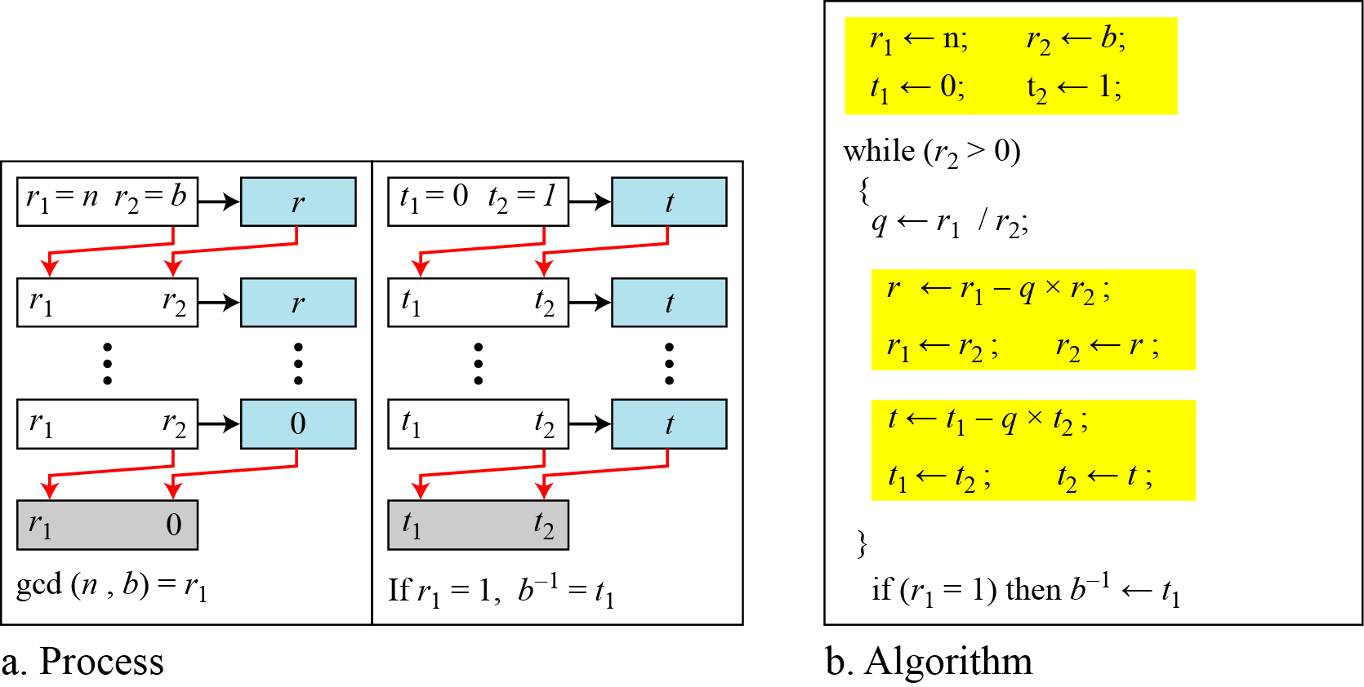

Slide 47
Find the multiplicative inverse of 11 in Z₂₆.
Solution
The gcd (26, 11) is 1; the inverse of 11 is −7 or 19.

Slide 48
Find the multiplicative inverse of 23 in Z₁₀₀.
Solution
The gcd (100, 23) is 1; the inverse of 23 is −13 or 87.

Slide 49
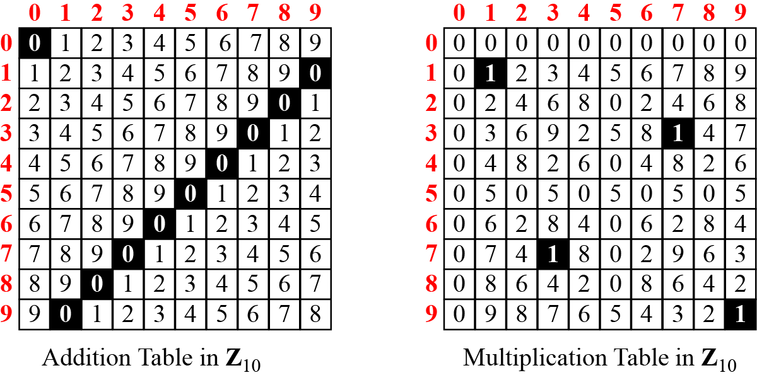
Addition and Multiplication Tables

